Slide 1
BeYonder is a profit for purpose, living wage employer
and is a supporter of the Scottish Business Pledge
David Scott
Director, BeYonder Ltd
CEO, BeYonder INVOLVE
@BeYonderLtd
www.beyonder.org.uk
Notes:
Good morning everyone. BeYonder’s development into the Circular Economy was deliberate strategy based on our decades of prior experience as both environmental and social activists. Specifically, can we use CE thinking to provide solutions that will save the planet without damaging inclusive growth. Our earliest concerns were for the marine environment because if the oceans die we die and so I would like you to pay attention to this short video:

Slide 3
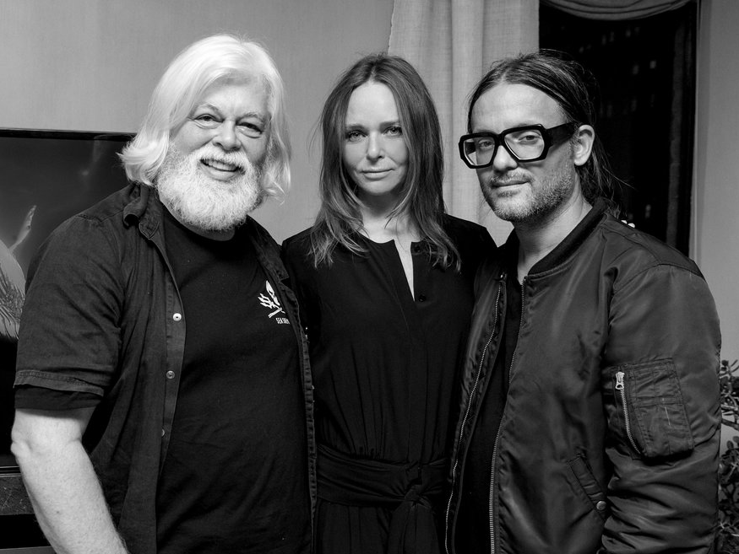
Notes:
Seen here are 3 amazing environmental activists – Paul Watson, the Founder of Sea Shepherd whose video you have just watched – he was also the youngest of the original founders of Greenpeace back in the day. Cyrill Gutsch, founder of Parley for the Oceans and Stella McCartney of the eponymous designer brand. This photo is from last year around the time Stella was launching her Circular Textiles collaboration with the Ellen McArthur Foundation. It shouldn’t be lost on you either that Stella has a long-standing collaboration with Adidas sports clothing.

Slide 4
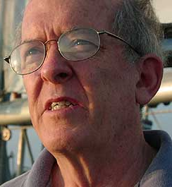
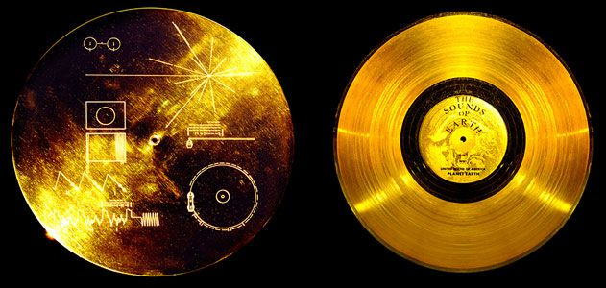
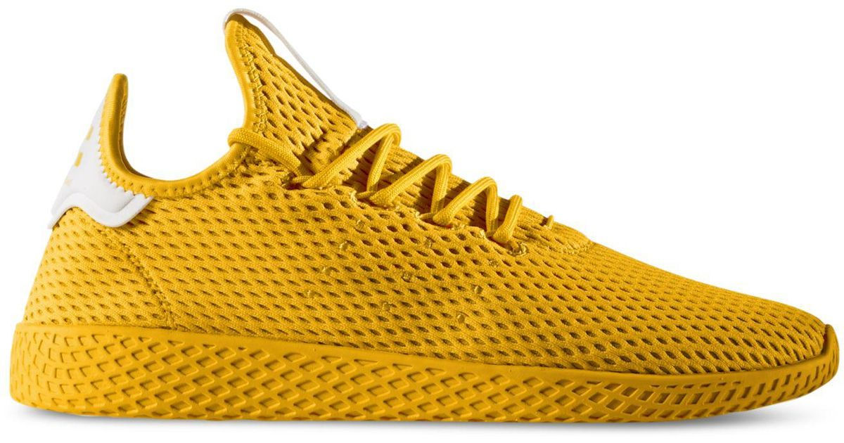
Notes:
Speaking of Adidas, here is the training shoe they made from several hundred miles of illegal long lines recovered by Sea Shepherd from the Southern Ocean. Also shown are Pharell Williams the singer and Dr Roger Payne, the bio-acoustician who has taught us all that we know about humpback whale-song. The gold disc of course belongs to Dr Payne as it includes humpback whale recordings sent into space on the Voyager 1 and 2 space probes. Naturally, none of us know what the whales are saying, so that might be a problem.

Slide 5
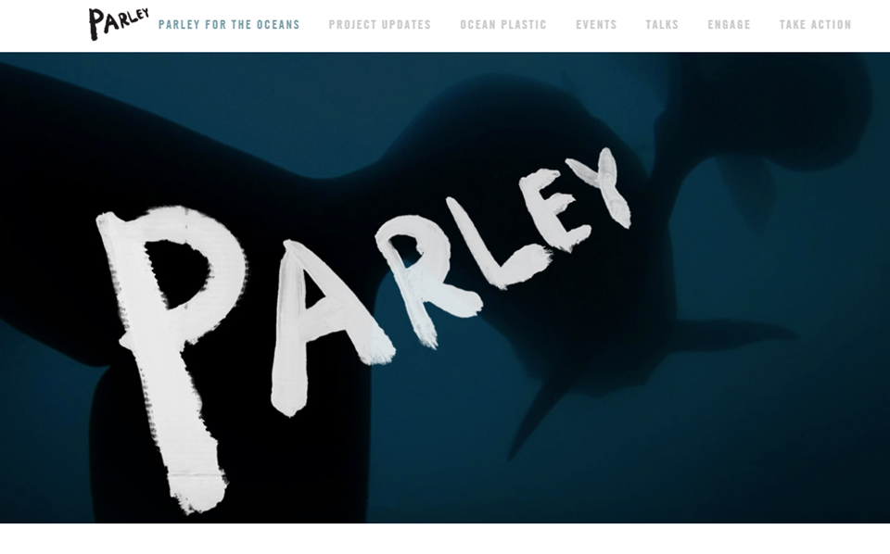
Notes:
Cyrill Gutsch got Paul Watson, Roger Payne and a whole load of A-List celebs, including Pharell Williams together for the first Parley for the Oceans in 2010. The thinking was to get the world’s best environmental scientists and activists together with environmentally conscious multi-millionaires and see what happened. The first practical output was a product called Bionic Yarn, made from the medium density plastics which don’t show up on our beaches but certainly show up in your fish and chips if that is your thing.

Slide 6
Notes:
That video is from 2013 so we think it is about time that Scotland made a contribution to the global textiles sector with some circular textile leadership of our own. We certainly have the expertise and with the political will to support those of us determined to make it happen I am certain the investment can be found.

Slide 7
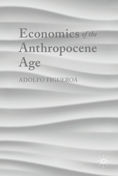
How to improve the quality of human life on Earth?
Economics of the Anthropocene Age
Adolfo Figueroa
ISBN 978-3-319-62584-3
A zero growth economy to control environmental degradation.
A zero growth society with income redistribution & a guaranteed minimum income financed by the taxation of global profits.
Notes:
Of course, as soon as we start looking at commercial investment we hit an environmental issue. Figuera’s conclusion is that we need to enforce zero growth to survive. And if we were simply to maintain business as usual he might have a point but..

Slide 8
How to improve the quality of human life on Earth?
Economics of the Anthropocene Age
Adolfo Figueroa
ISBN 978-3-319-62584-3
A zero growth economy to control environmental degradation.
A zero growth society with income redistribution & a guaranteed minimum income financed by the taxation of global profits.
Notes:
Of course, as soon as we start looking at commercial investment we hit an environmental issue. Figuera’s conclusion is that we need to enforce zero growth to survive. And if we were simply to maintain business as usual he might have a point but..

Slide 9
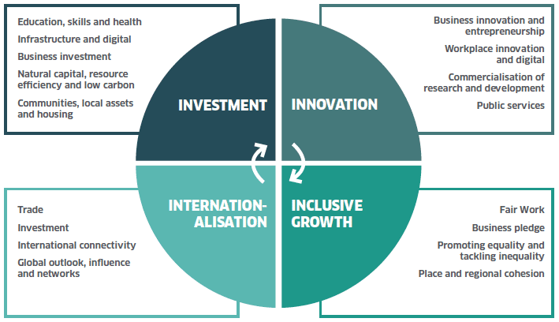
A zero growth economy to control environmental degradation.
A zero growth society with income redistribution & a guaranteed minimum income financed by the taxation of global profits.
Notes:
In Scotland we have 4 principles to guide our economic growth and the one we at BeYonder are most focused on is Inclusive Growth. That alone will address a lot of Figuera’s concerns.

Slide 10
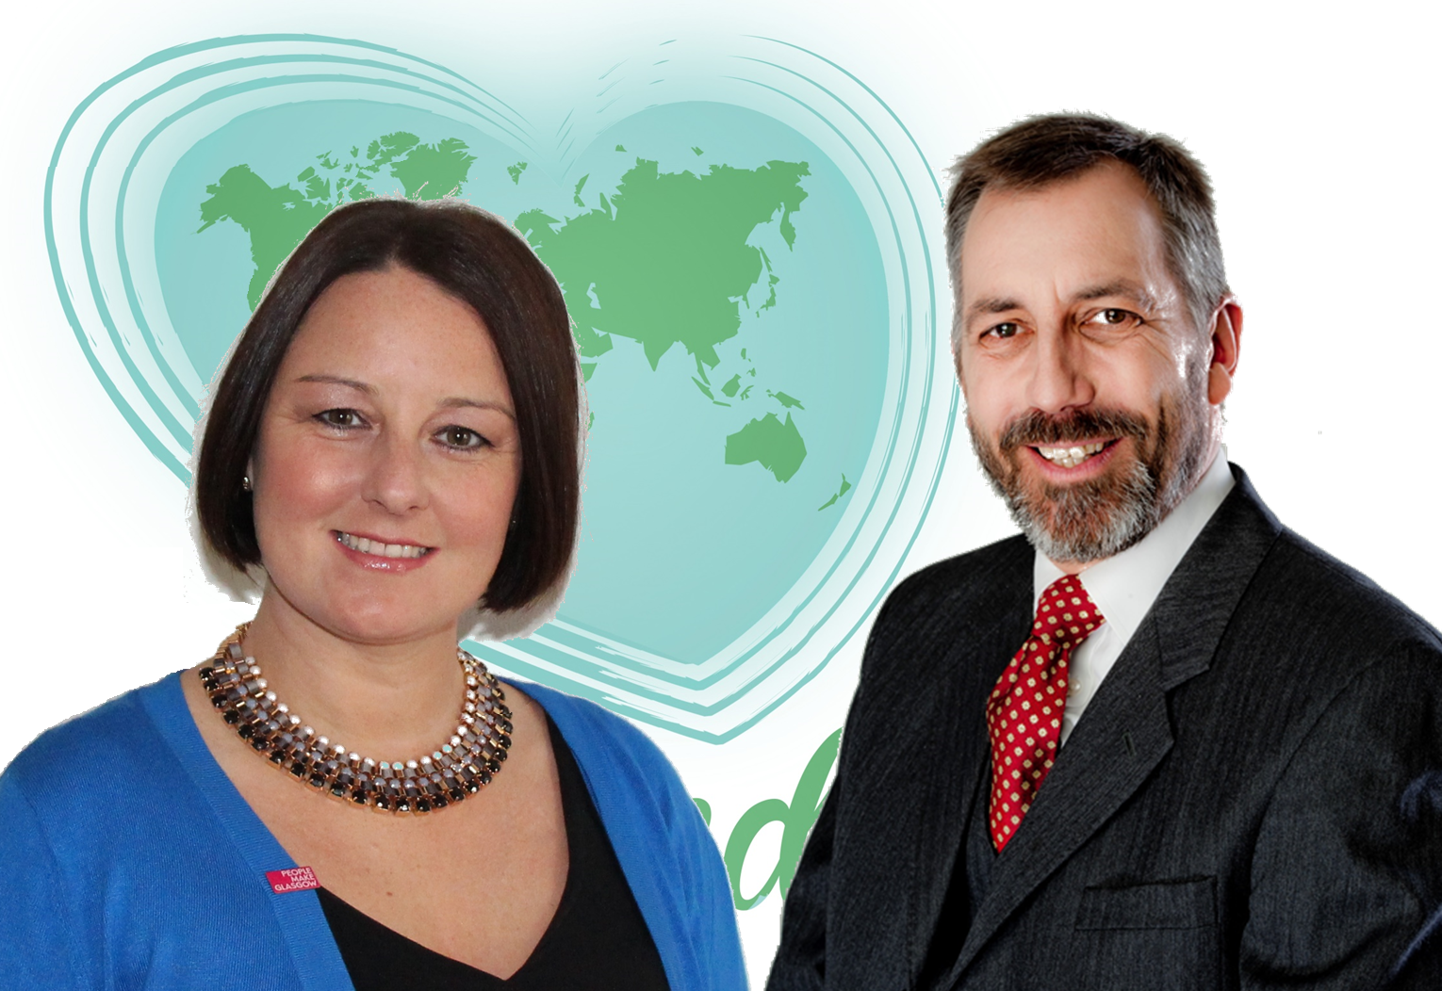
BeYonder Ltd
Centralised Functions
HR, Procurement, Facilities, Etc.
BeYonder
INVOLVE
BeYonder
Projects
BeYonder
Weekenducate
BeYonder
Digital
BeYonder
Textile
BeYonder
White Label
BeYonder
Client Label
BeYonder
Hat & Soul
BeYonder
Joint Ventures
INVOLVE
Joint Projects
Notes:
BeYonder is now in its 6th trading year and I am delighted that our founder and business leader, Chrissy Mackay, is here today, so please get to talk to her in the networking sessions. I fill the chief of staff role so, on our wiring diagram, Chrissy is responsible for all the boxes and I am responsible for all the white space.

Slide 11
BeYonder Textile
Design to Remanufacture
Ethical Material Sourcing
Design to Deconstruct
BeYonder is an enabling business, structured to assist early-stage start ups and growing businesses of any age take their product designs from initial concept to finished product.
Notes:
This is the space our textile division lives in – pretty much the fashion and fabric equivalent of TRLs 3 to 6 so, yes, we are already well practised at navigating our way through Lindstrom’s “Innovation Valley of Death”. In addition, we offer our clients ethical fabric sourcing and work with academic partners for Design to Deconstruct. That is essential if we are going to Design to Remanufacture which is itself essential if we are to achieve true circularity rather than simply minimising losses between linear business nodes.

Slide 12
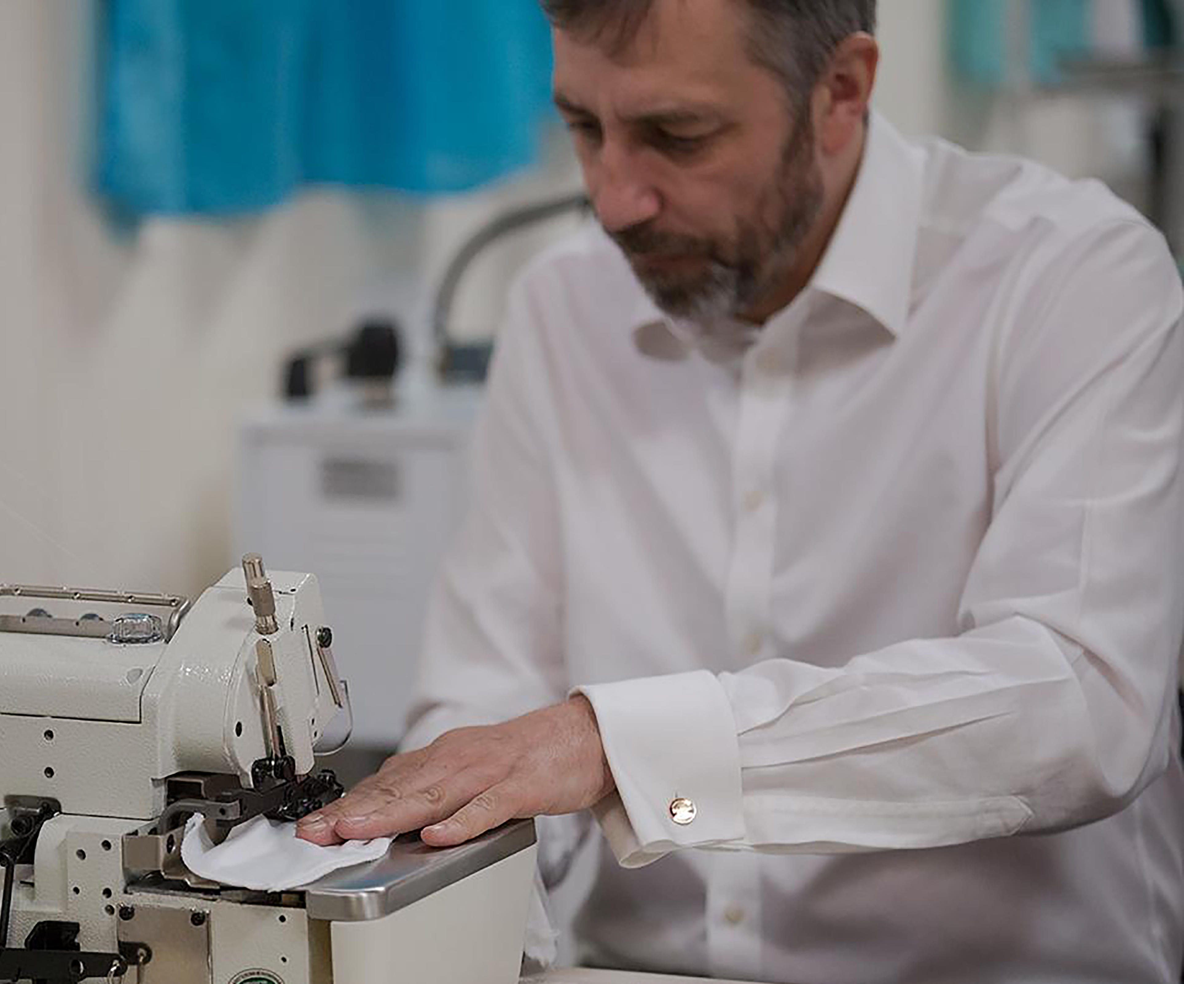
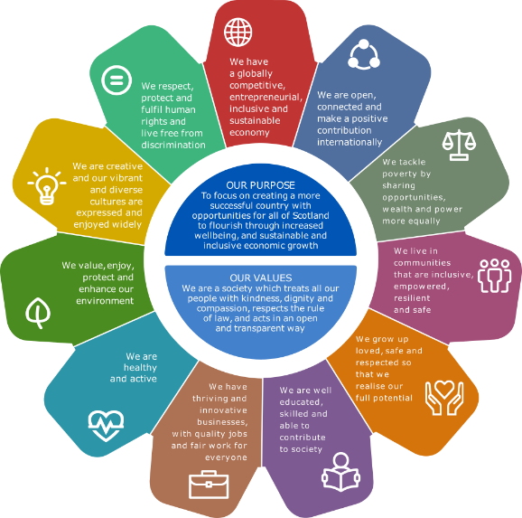
BeYonder Textile specialises in prototyping, sampling, small batch and bespoke manufacturing for independent product design engineers, fashion designers and other end users of high quality, textile-based items.
Notes:
As social activists we are very people focused. We were one of the earliest sign ups to the Scottish Business Pledge which goes way beyond just the living wage, we have mapped our strategic development to the 55 metrics of the Scottish National Performance Framework which itself directly supports the UN Sustainable Development Goals and we are one of Scotland’s 10 Purpose Pioneer organisations within the Scotland Can B movement.

Slide 13
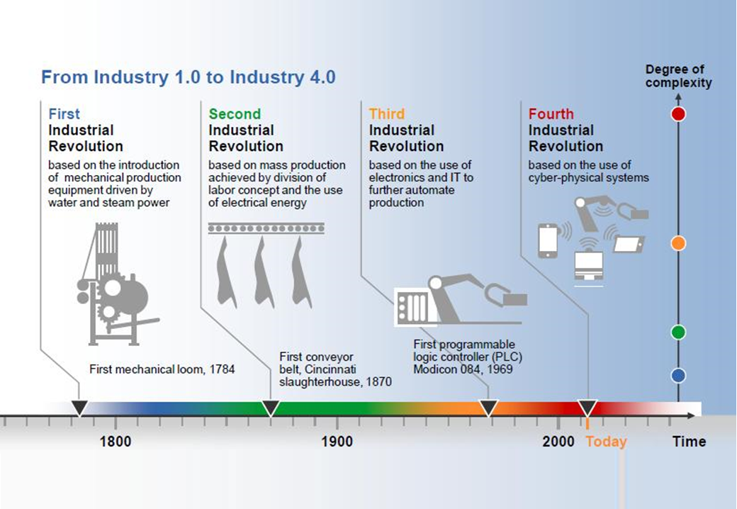
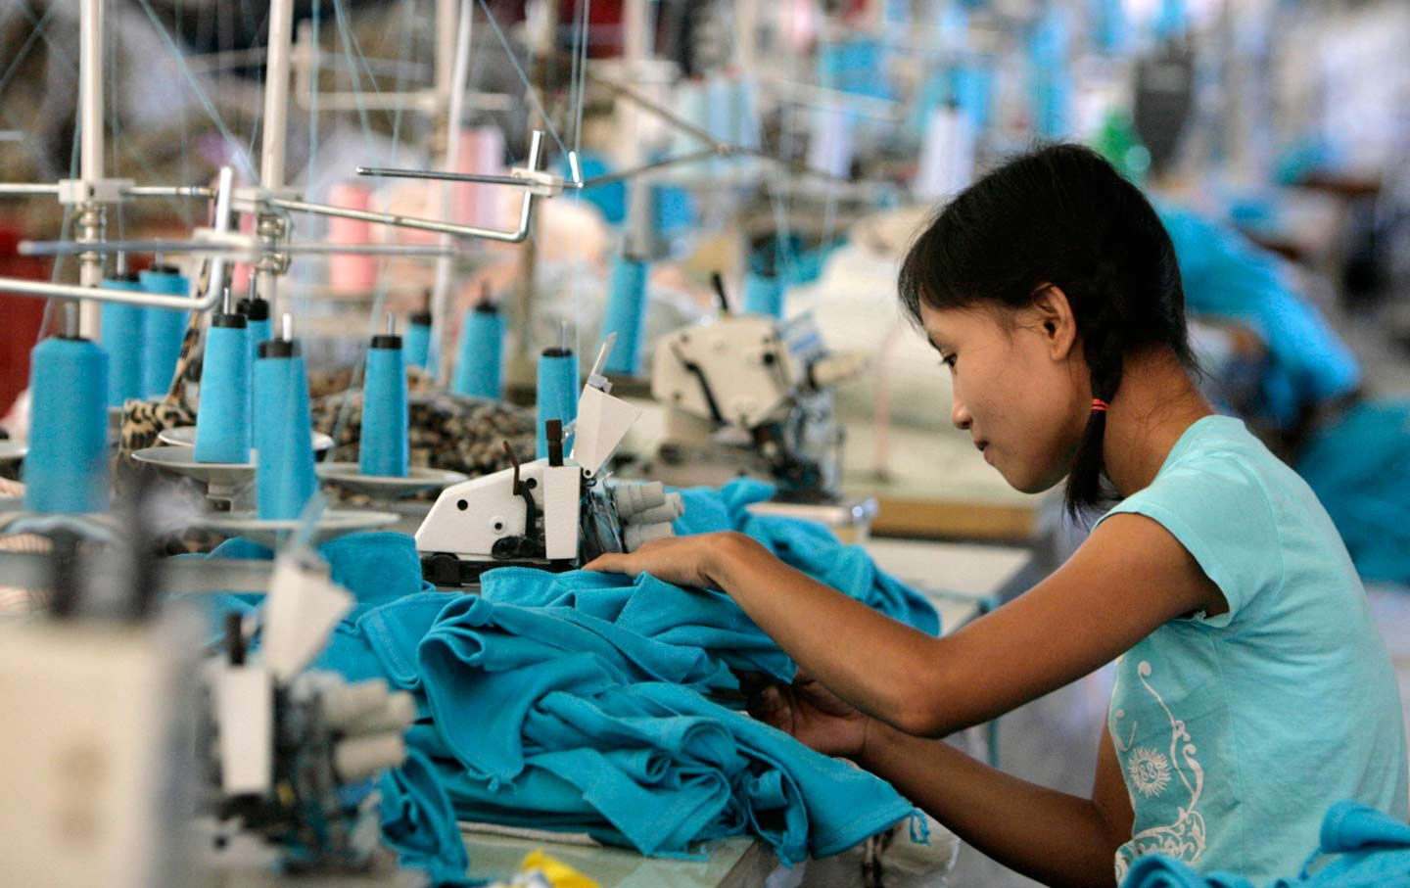
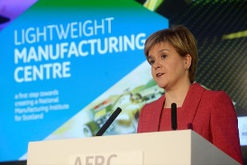
Scotland has the opportunity to once more lead the World in textile innovation in a way which creates jobs which are both desirable and sustainable and which fully support our National priorities.
… if we’re going to build it anyway, what do we want it to look like?
Notes:
Sadly, the textile industry has not been people friendly. The ready availability of ultra-low-cost labour has stifled innovation and ensured that ethical manufacturers are producing only for the moneyed classes. If we were to take a factory worker out of a 1918 factory and drop her – it would be a her – into a 2018 factory, she would require zero additional training to continue working. But to remain competitive, her wages would be reduced and her hours increased. That simply cannot be acceptable in a modern democracy such as ours. It should not be acceptable anywhere.
The Future of Textiles in the Scottish Economy therefore is dependent on businesses like ours, being directly supported by centres of excellence such as the AFRC, to innovate under the umbrella of a National Performance Framework and deliver a circular economy solution that puts Scotland back at the forefront of global textiles.

Slide 14
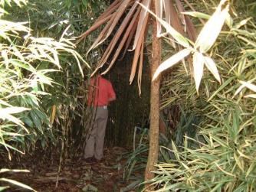
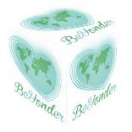
Recover / Shred / Grow – Process
Spin
Weave
Future
Textiles
Digital
Deconstruct / Recover / Sort
Use / Re-use (Rent)
Make / Re-make
Notes:
Working with Scottish Enterprise, the AFRC, University of Strathclyde Business School and other key centres of influence we have highly advanced plans for major investment in a high-volume, high-variety showcase facility which will draw on global best practice in reclamation and recycling, leading to technological innovation in new yarns whilst re-inventing 3 “traditional” industries as Industry 4.0 exemplars. This will lead directly to Development of new yarns and fabrics plus the revitalisation of Scottish Spinning, Scottish Weaving and, of course, Scottish Textile Manufacturing.
The end result will be a massive reduction of textile waste in Scotland; significant new primary employment; substantial new secondary employment; export opportunities potentially bigger than Harris Tweed for both yarns and woven fabrics; the enabling technology and supply chain elements for spin-out businesses; an educational platform for schools, colleges, universities and entrepreneurial incubators and accelerators; and a growing acknowledgement of Scottish leadership in environmental responsibility for textiles.
The mantra we have developed at BeYonder is that Knowledge is Responsibility. If you would like to share our journey then please come and talk to us.

Slide 15
Open Forum
Notes:
Thank you.

